Slide 1
Back to School
Fairburn Academies
First and Second Grade
2018-2019

Slide 2
ELLP Academies What is it?
Is a foundational skill block that addresses the language and literacy needs of all students.
Address the needs of early emergent to fluent readers.
Focus on targeted instruction for Foundational Skills and beyond.
Accelerate instruction and intervention for students in grades K-2.
Ensure that all students are reading by age 9 as per the ELA/ELD Framework.

Slide 3
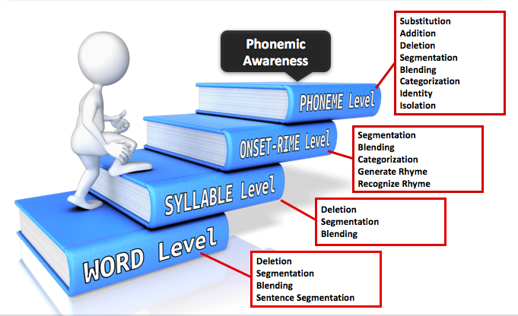
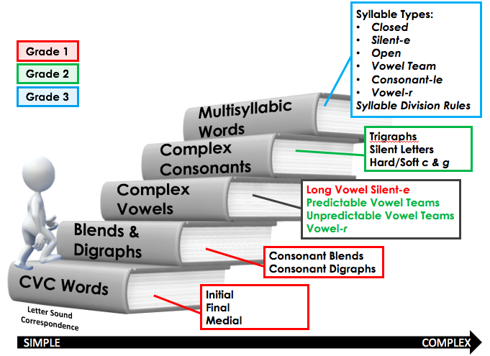
Foundational Literacy Skills
Phonological Awareness Continuum
Phonics Continuum
Kindergarten
Notes:
Box on the LEFT:
This is representation of the continuum of phonological awareness. Skills that should be mastered by the end of Kindergarten. There are 4 levels: word, syllable, Onset-rime, and phoneme. Each level has a number of skills that are arranged from easiest to more difficult (bottom to top). The phoneme level is the most difficult.
Box on the RIGHT:
Sequence of Skills
This is representation of the continuum of phonics. This slide shows the a sequences of skills arranged according to difficulty. This continuum also includes a suggested grade level for skill mastery. End of Gr 1-Short vowel and the long vowel silent-e pattern. End of Gr 2-Remaining long vowel patterns, r-controlled vowels, and complex consonants. Gr 3 – Multi-syllable words
Several foundational skills are necessary before beginning instruction of basic phonics patterns. Students must display accuracy and fluency in sound segmentation & blending and in sound symbol correspondence.

Slide 4
Fairburn Academy Details
We’ve used the DIBELS screener to identify needed literacy skills for all first and second grade students.
We will commence Academies on Wednesday, August 29.
Commencing Academies means your child may move to another teacher for the 40 minute Foundational Skills block or for Reading enrichment.

